Slide 1
Colors
Black
PMS Pantone Black
CMYK 0-0-0-100
RGB 0-0-0
HEX #000000
Aqua
PMS 7474 CP
CMYK 96-9-32-29
RGB 0-123-140
HEX #007B8C
Red
PMS 186
CMYK 0-100-81-4
RGB 204-9-47
HEX #CC092F
Dark Gray
PMS Cool Gray 11
CMYK 0-0-0-80
RGB 83-86-90
HEX #53565A
White
CMYK 0-0-0-0
RGB 255-255-255
HEX #FFFFFF
Purple
PMS 7678 C
CMYK 74-85-0-0
RGB 108-75-148
HEX #6C4B94
Orange
PMS 138 CP
CMYK 0-52-100-0
RGB 230-140-40
HEX #E68C28
Cool Gray 7
PMS Cool Gray 7
CMYK 0-0-0-48
RGB 151-153-155
HEX #97999B
Dark Blue
PMS 4146
CMYK 100-82-0-81
RGB 27-29-54
HEX #1B1D36
Azure
PMS 313 CP
CMYK 100-0-11-2
RGB 0-152-199
HEX #0098C7
(AA Compliant)
RGB 0-125-163
HEX #007DA3
Yellow
PMS 7408 CP
CMYK 0-29-100-0
RGB 243-186-22
HEX #F3BA16
Broadcom Gray
CMYK 0-0-0-12
RGB 226-227-228
HEX #E2E3E4
Blue
PMS 7469 C CMYK 96-64-24-6 RGB 0-92-138 HEX #005C8A
Green
PMS 369 C
CMYK 67-12-100-1
RGB 97-166-14
HEX #61A60E
(AA Compliant)
RGB 35-128-10
HEX #23800A

Slide 2
VCF Low Level Design Diagrams
VCF Automation Models

Slide 3
VCF Constructs v1
VCF Private Cloud
VCF Fleet
VCF Fleet
VCF Operations
VCF Operations
VCF Automation
VCF Automation
VCF Instance
VCF Instance
Management Domain
Management Domain
vCenter
vCenter
NSX
NSX
SDDC Manager
SDDC Manager
Workload Domains
Workload Domains
Additional VCF Instances
Additional VCF Instances

Slide 4
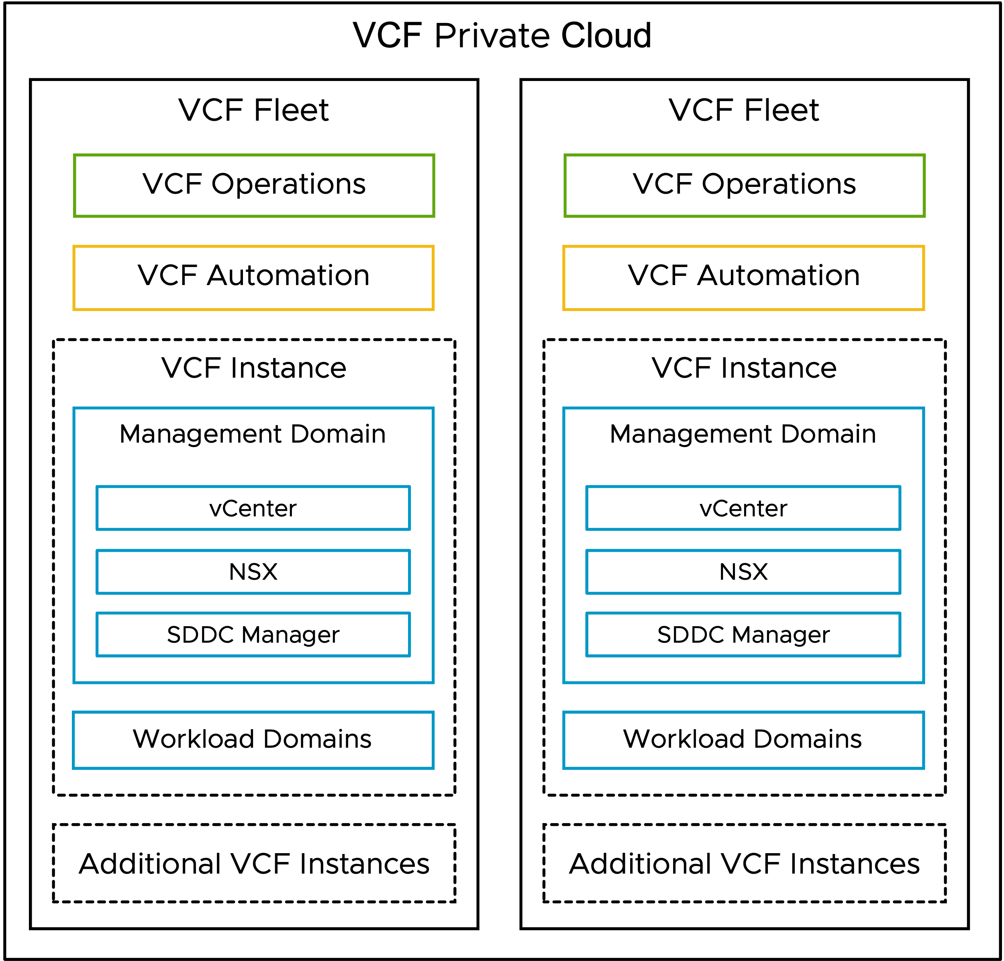
VCF Constructs v1 (SVG Image)

Slide 5
VCF Automation Models

Slide 6
VCF Automation Models v1
Simple - VCF Automation
High Availability - VCF Automation
VCF Automation
VCF Automation
Native Load Balancer
Native Load Balancer
VCF Automation
(Node 1)
VCF Automation
(Node 1)
VCF Automation
(Node 2)
VCF Automation
(Node 3)
Connections
Connections
Management Domain
Workload Domain
Management Domain
Workload Domain
vCenter
vCenter
vCenter
vCenter
NSX Manager
NSX Manager
NSX Manager
NSX Manager

Slide 7
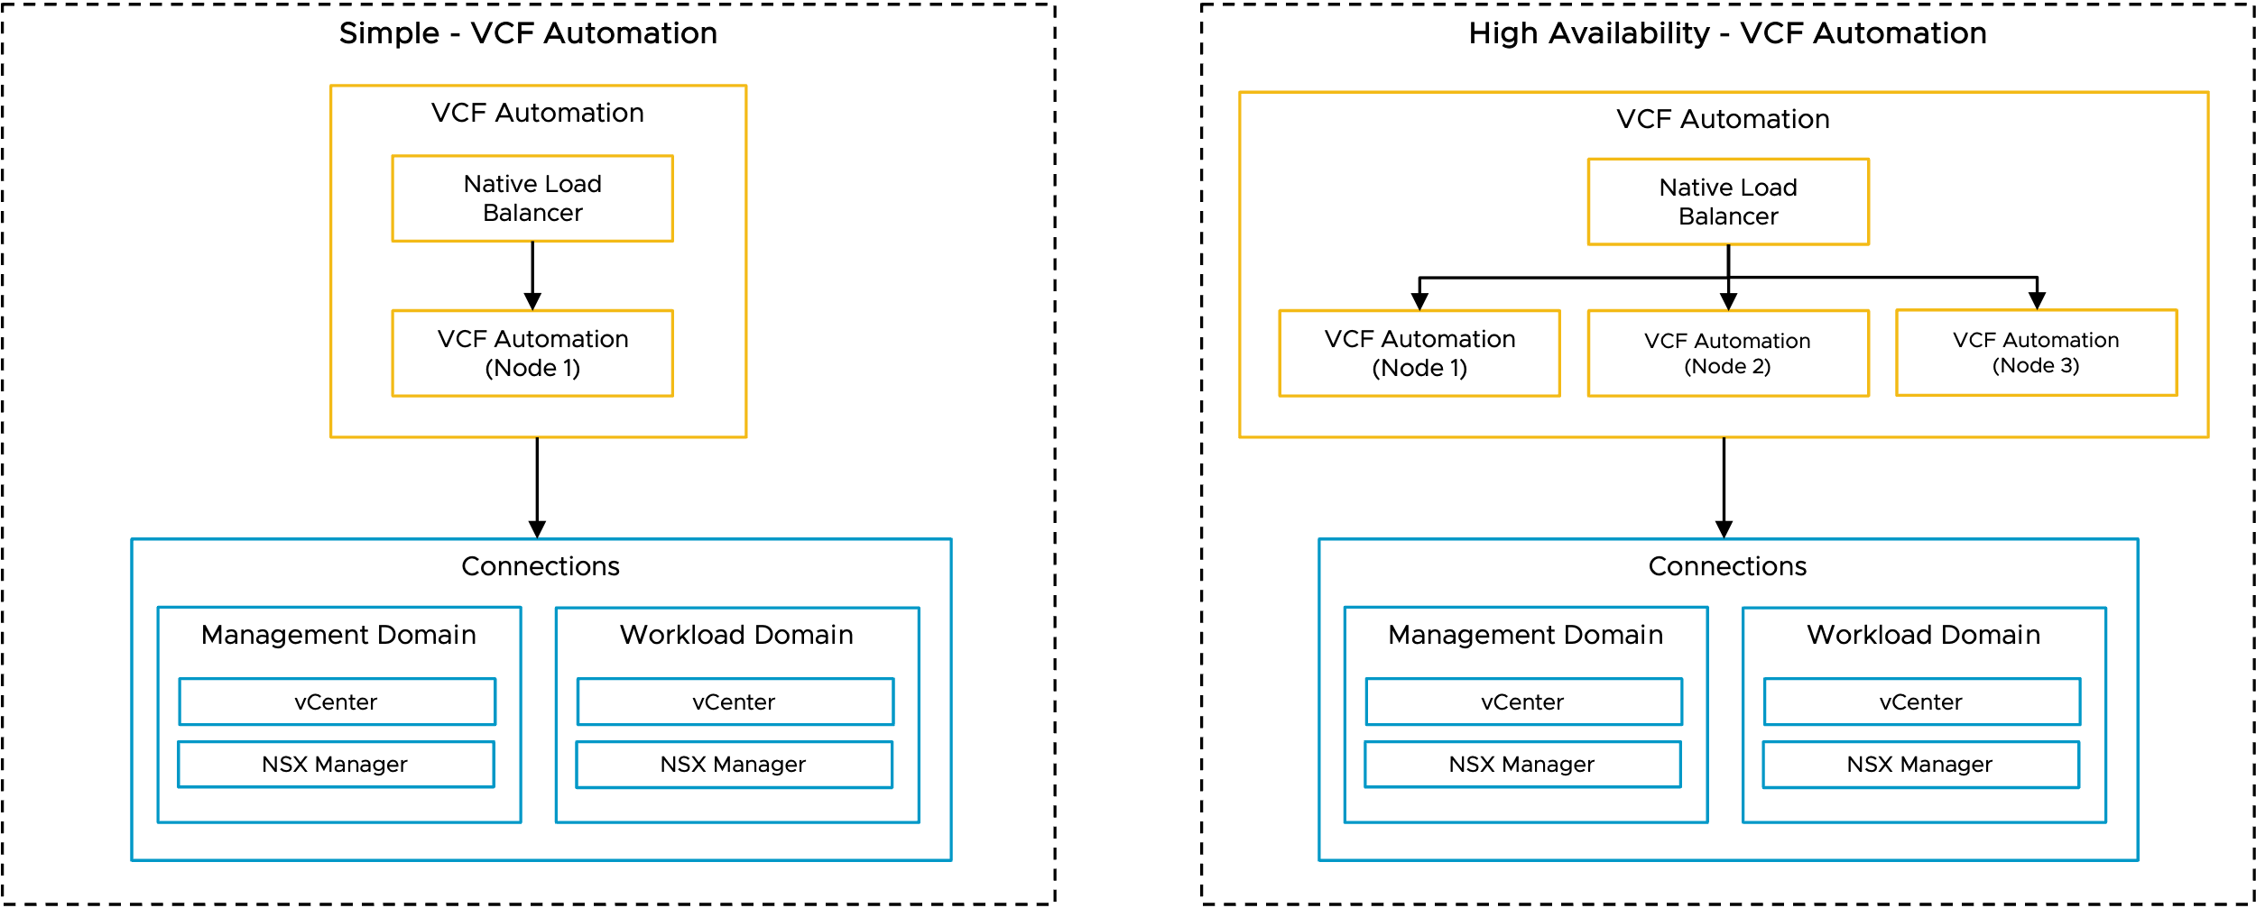
VCF Automation Models v1 (SVG Image)

Slide 8
VCF Simple and HA Models Combined v2
Simple – VCF Automation
High Availability – VCF Automation
VCF Automation
VCF Automation
Native Load Balancer
Native Load Balancer
VCF Automation (Node 1)
VCF Automation (Node 1)
VCF Automation (Node 2)
VCF Automation (Node 3)
Management Domain
Workload Domain
Management Domain
Workload Domain
vCenter
vCenter
vCenter
vCenter
NSX Manager
NSX Manager
NSX Manager
NSX Manager

Slide 9
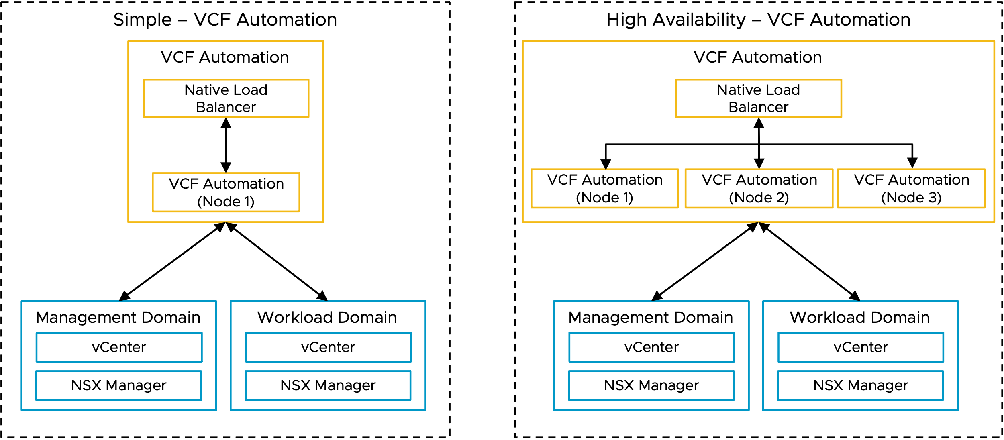
VCF Simple and HA Models Combined v2 (SVG Image)

Slide 10
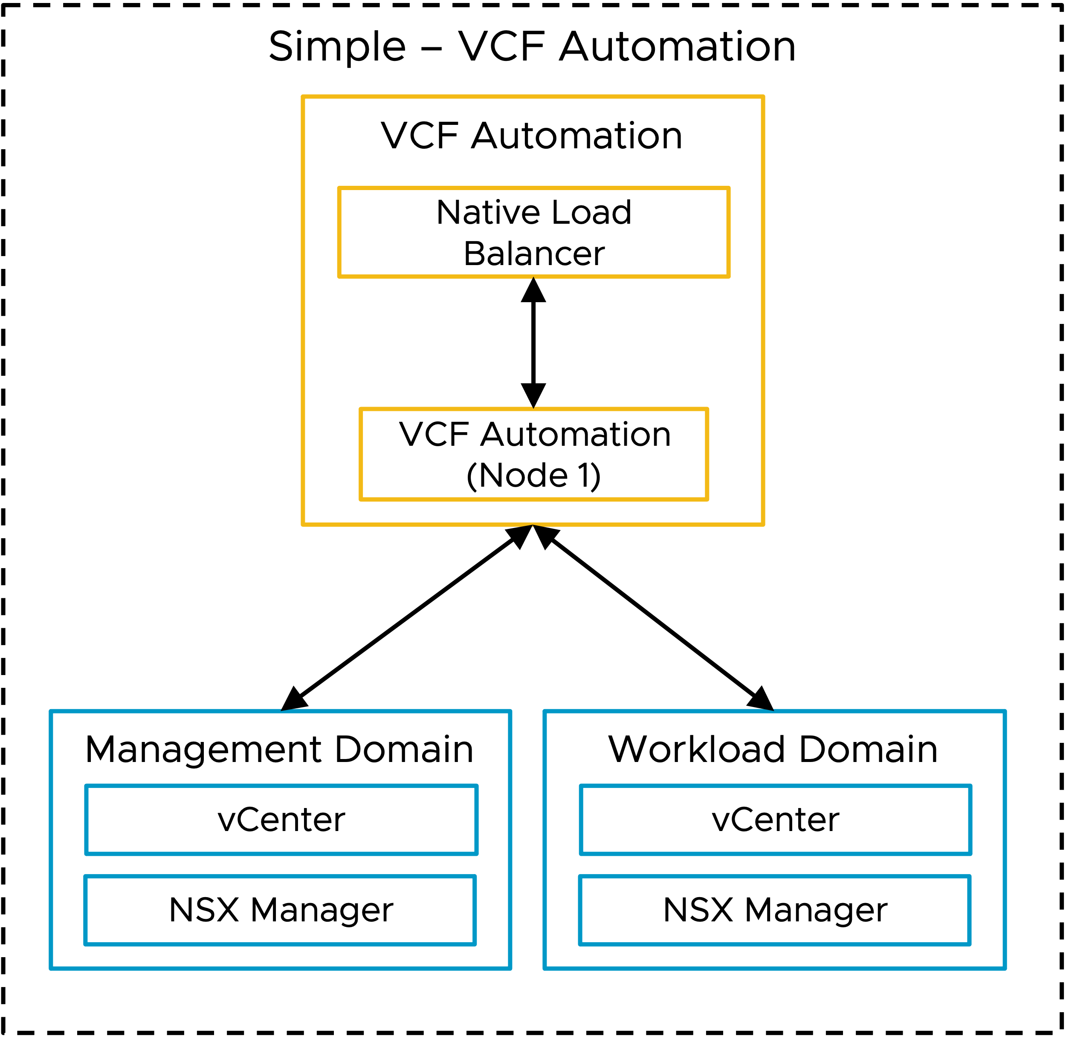
VCF Simple Model (SVG Image)

Slide 11
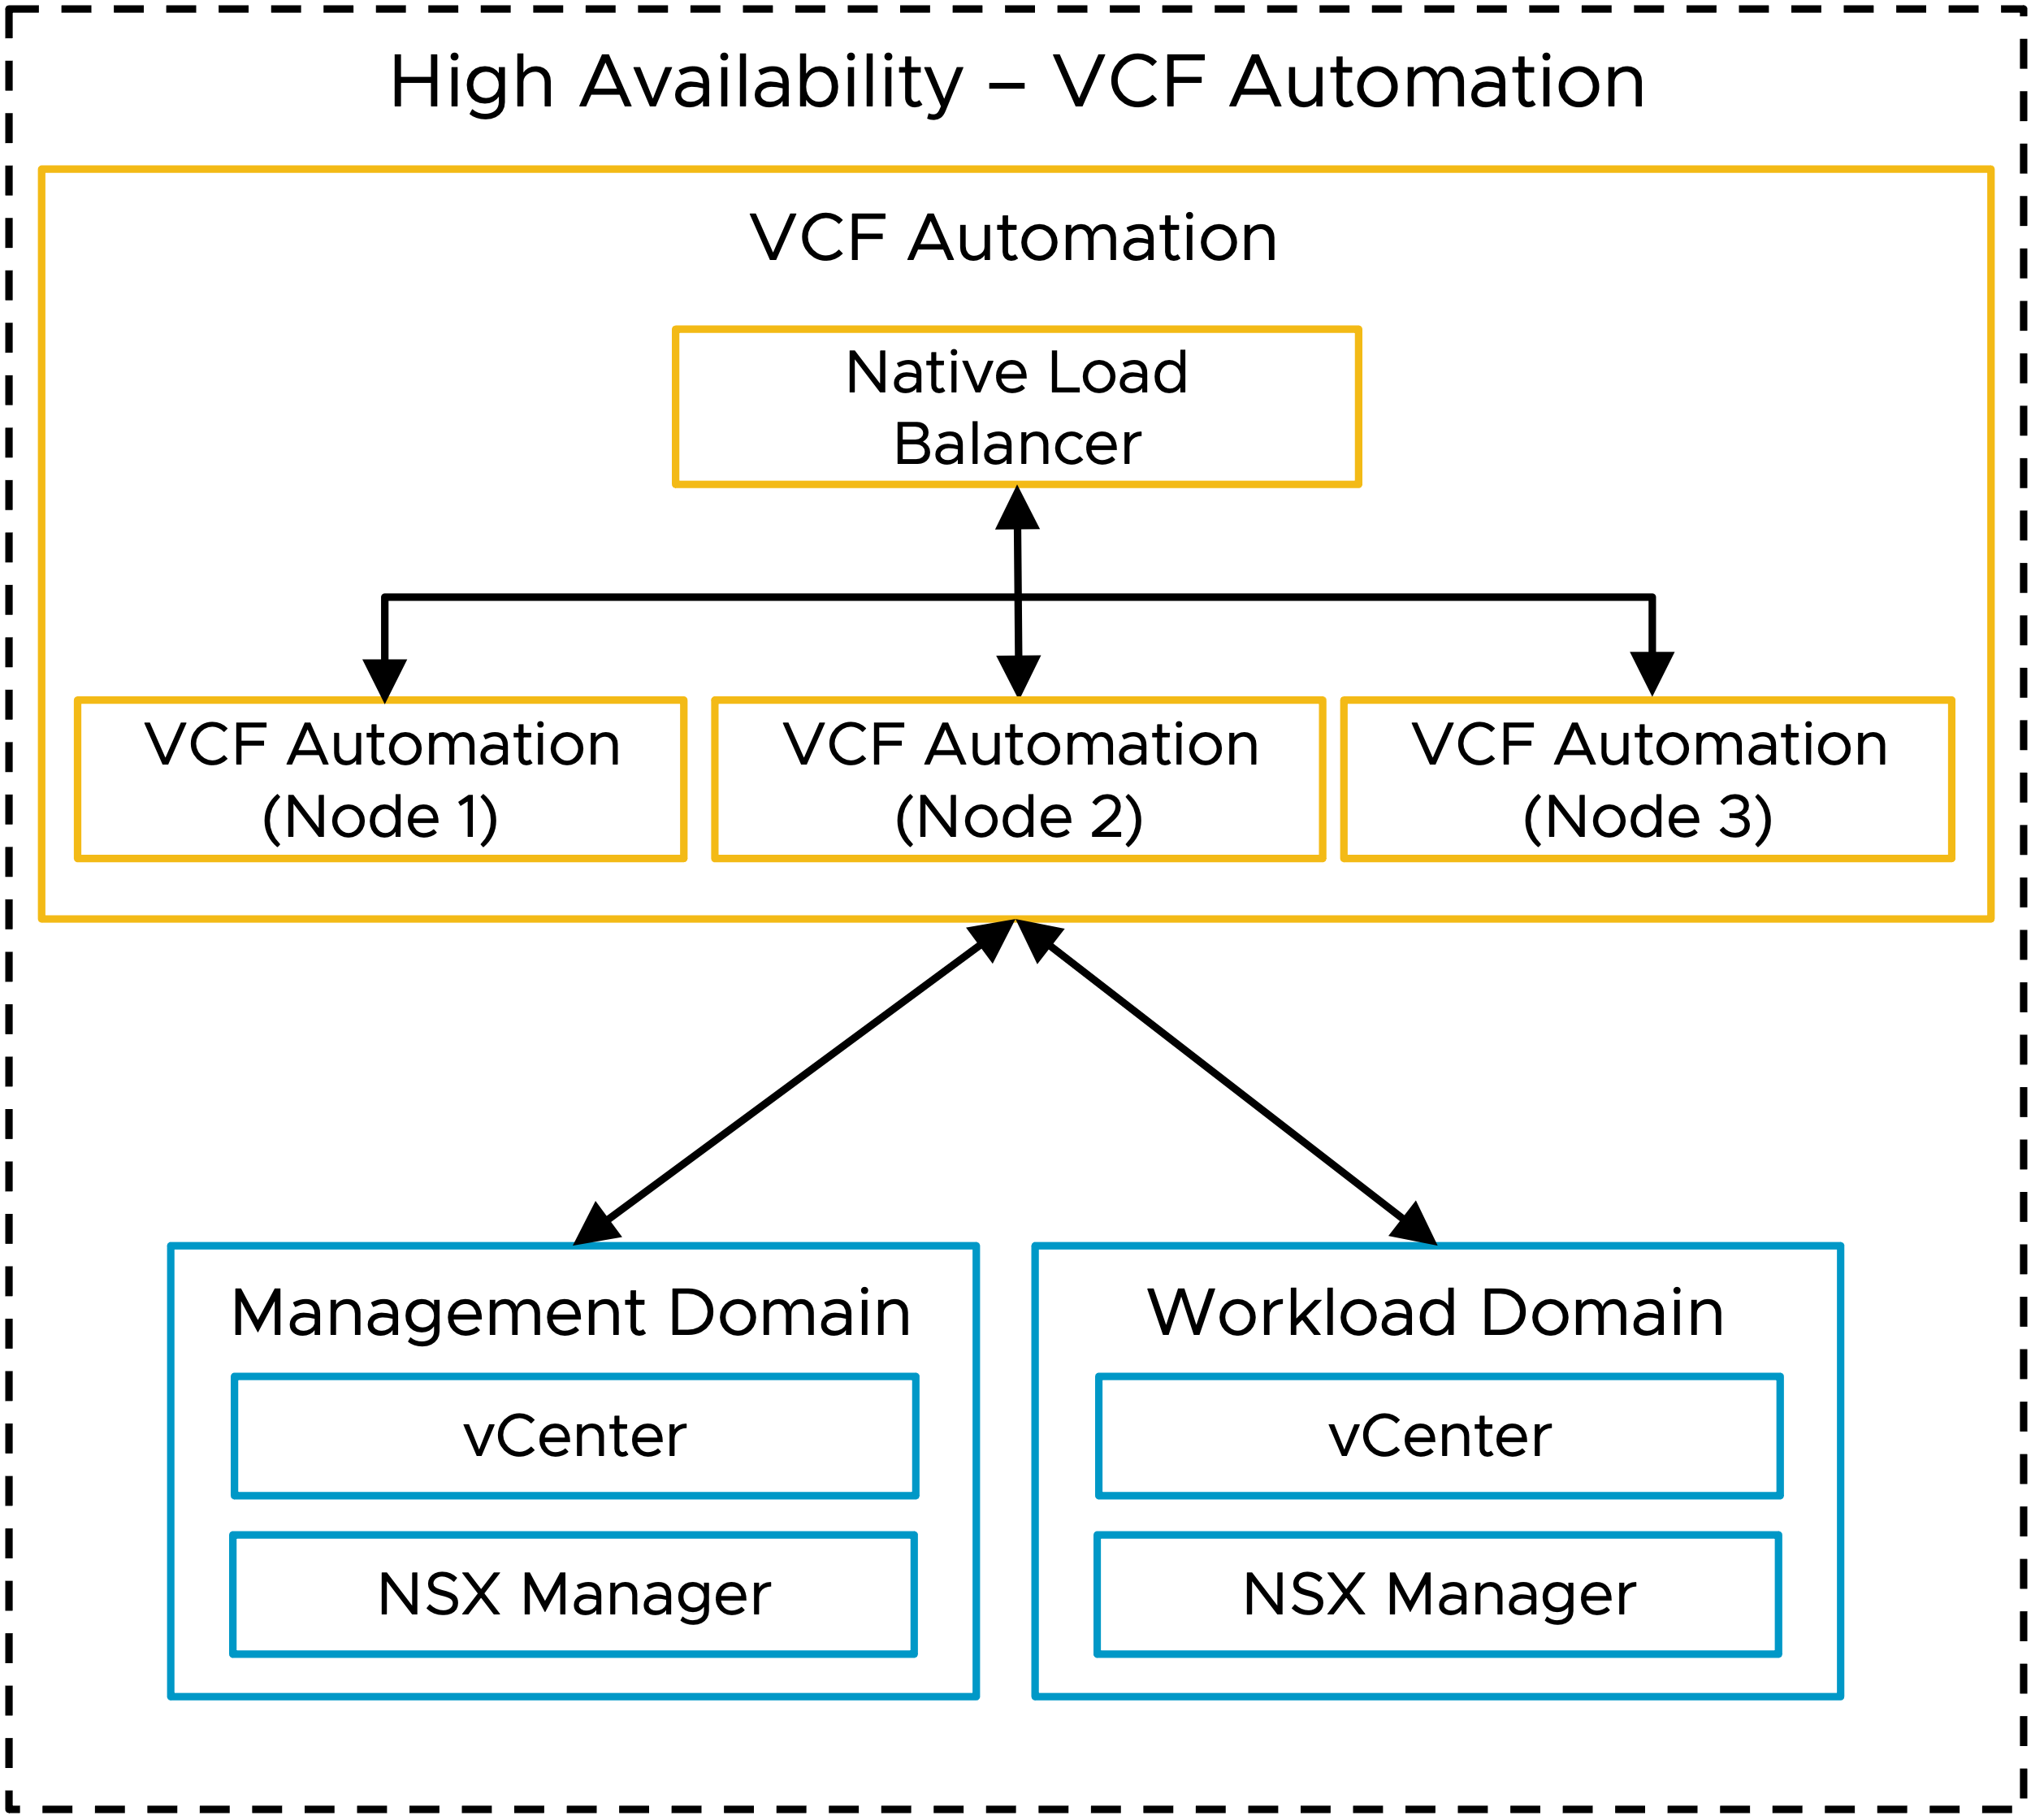
VCF HA Model v2 (SVG Image)

Slide 12
VCF Simple and HA Models Combined w/ External LB v2
Simple – VCF Automation
High Availability – VCF Automation
VCF Automation
VCF Automation
External Load Balancer (Optional)
External Load Balancer (Optional)
Native Load Balancer
Native Load Balancer
VCF Automation (Node 1)
VCF Automation (Node 1)
VCF Automation (Node 2)
VCF Automation (Node 3)
Management Domain
Workload Domain
Management Domain
Workload Domain
vCenter
vCenter
vCenter
vCenter
NSX Manager
NSX Manager
NSX Manager
NSX Manager

Slide 13
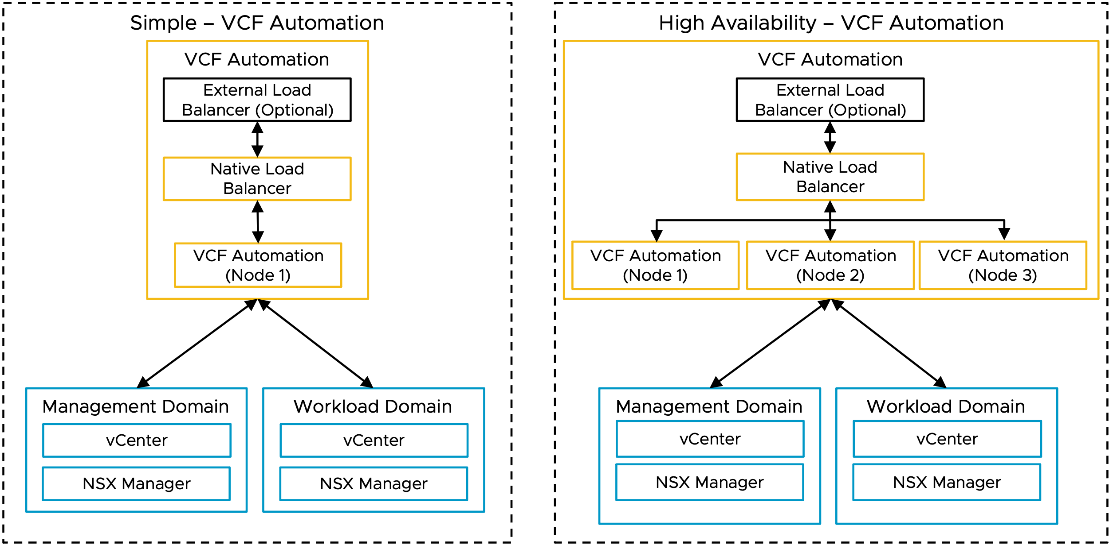
VCF Simple and HA Models Combined w/ External LB (SVG Image)

Slide 14
VCFA Object Flow v2
Organization Construct Hierarchy
Organization
Project
vSphere Supervisor
VCF Networking with VPC
VM Workloads
vSphere Namespace
Container Workloads
Notes:
Talk Track:
This is a high-level view of the constructs that comprise an Organization
Organizations – A top-level entity used to group and manage resources, users, policies, IaaS services, and catalog entities, while maintaining a secure boundary from other organizations
Projects – Connect users with the resources they are entitled to and the limits to which they are subject
Supervisor Clusters - Built on VKS using VCF Networking with Virtual Private Clouds (VPCs)
VCF Networking with VPC - Provides an isolated domain of networking resources that can be associated with one or more isolated domains of compute resources (vSphere namespace)
vSphere Namespaces - Define resource limits for CPU, memory, and storage for workloads such as VMs, Kubernetes clusters, and others
Workloads - Traditional VMs and container-based deployments within same infrastructure & managed with the same tools

Slide 15
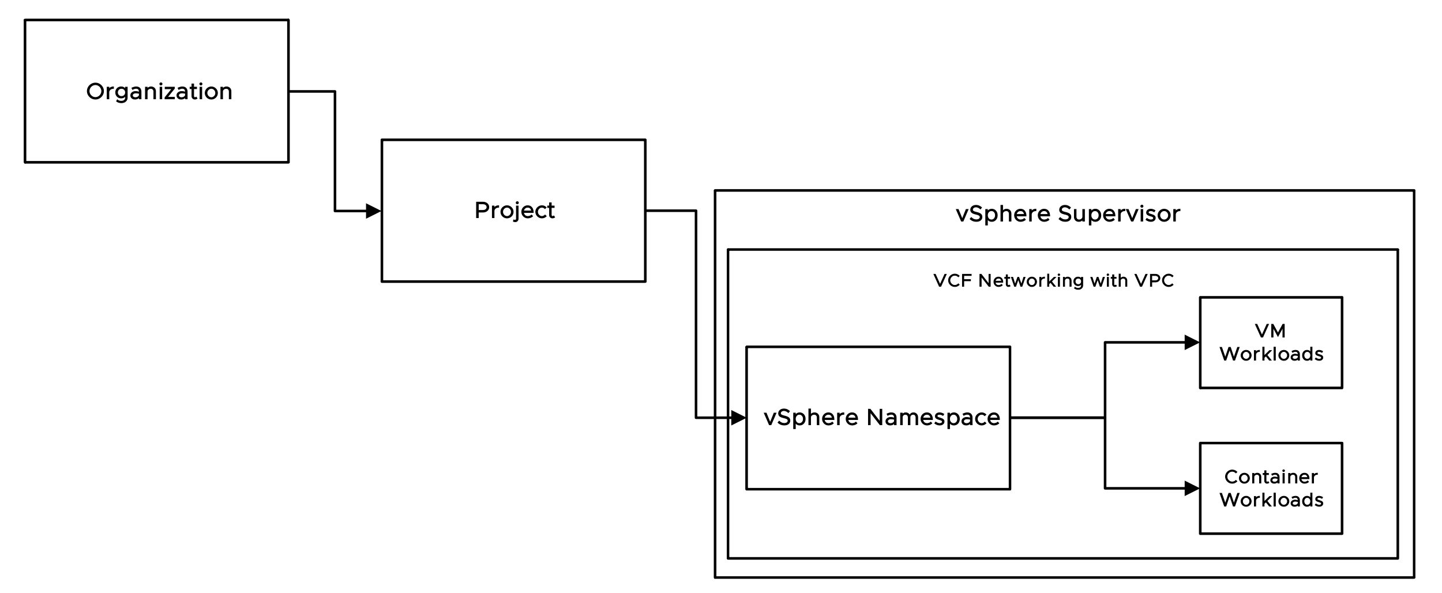
VCFA Object Flow (SVG Image)
Organization Construct Hierarchy
Notes:
Talk Track:
This is a high-level view of the constructs that comprise an Organization
Organizations – A top-level entity used to group and manage resources, users, policies, IaaS services, and catalog entities, while maintaining a secure boundary from other organizations
Projects – Connect users with the resources they are entitled to and the limits to which they are subject
Supervisor Clusters - Built on VKS using VCF Networking with Virtual Private Clouds (VPCs)
VCF Networking with VPC - Provides an isolated domain of networking resources that can be associated with one or more isolated domains of compute resources (vSphere namespace)
vSphere Namespaces - Define resource limits for CPU, memory, and storage for workloads such as VMs, Kubernetes clusters, and others
Workloads - Traditional VMs and container-based deployments within same infrastructure & managed with the same tools

Slide 16
Org Hierarchy with VPC v2
VCF Automation
Organization 01
Organization 01
Project 01
Project N
Project 01
Project N
VCF Networking with VPC
VCF Networking with VPC
VCF Networking with VPC
VCF Networking with VPC
VCF Networking with VPC
VCF Networking with VPC
VCF Networking with VPC
VCF Networking with VPC
vSphere Namespace 01
vSphere Namespace N
vSphere Namespace 01
vSphere Namespace N
vSphere Namespace 01
vSphere Namespace N
vSphere Namespace 01
vSphere Namespace N
Workload 1
Workload 1
Workload 1
Workload 1
Workload 1
Workload 1
Workload 1
Workload 1
Workload 2
Workload 2
Workload 2
Workload 2
Workload 2
Workload 2
Workload 2
Workload 2
Workload N
Workload N
Workload N
Workload N
Workload N
Workload N
Workload N
Workload N

Slide 17
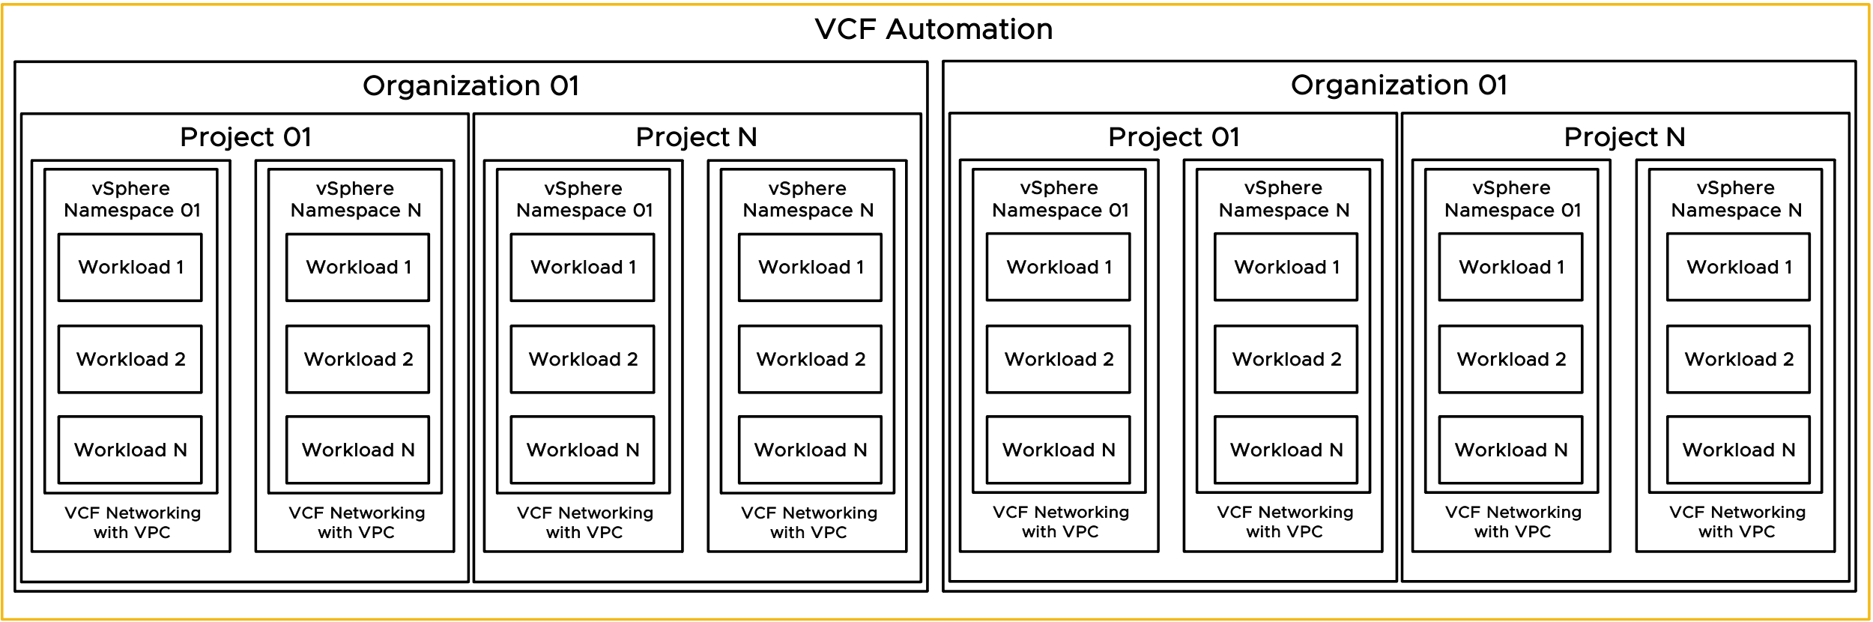
Org Hierarchy with VPC (SVG Image)

Slide 18
Provider Consumption Org v1
Flow Chart
VCF Automation
Provider / Enterprise Admin
Provider Management Functions
Provider Consumption Organization (PCO)
Visibility to allow for publishing of catalog items from PCO to Organizations
Organization 1
Organization 2
Organization N

Slide 19
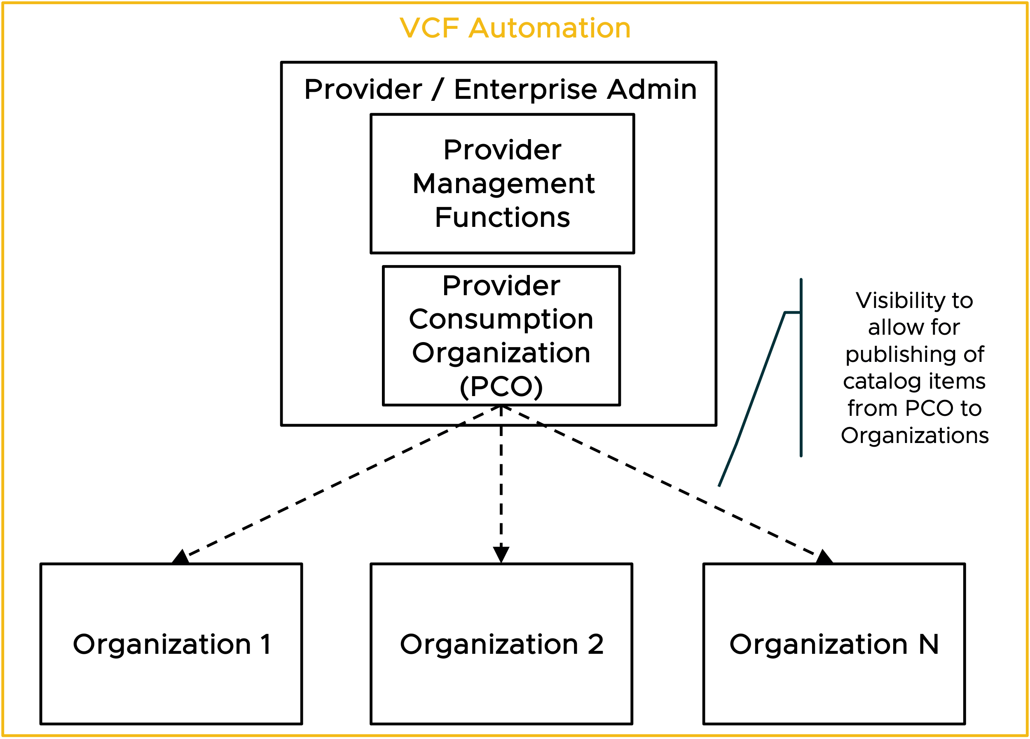
Provider Consumption Org (SVG Image)
Flow Chart

Slide 20
Example – Supervisor to Organization Relationship v1
Shared Infrastructure
Organization BigCo
Organization SmallCo
Tenant Level
Project - Apple
Project - Pear
Project - Corp
vSphere Namespace: Crisp
vSphere Namespace: Bartlett
BigCo
Org
Admins
vSphere Namespace: Finance
SmallCo
Org
Admins
vSphere Namespace: Mac
vSphere Namespace: Bosc
vSphere Namespace: Plant
zone1
zone2
zone3
zone4
zone5
zone6
zone1
zone2
zone3
Provider Level
vSphere
Cluster
vSphere
Cluster
vSphere
Cluster
vSphere
Cluster
vSphere
Cluster
vSphere
Cluster
vSphere
Cluster
vSphere
Cluster
vSphere
Cluster
Region West
vSphere Supervisor 1
Region East
Provider Admins
vSphere Supervisor 2
vSphere Supervisor 1
vCenter West 1
vCenter West 2
vCenter East 1
NSX Local Manager West
NSX Local Manager East
Notes:
Talk Track:
Technical view of showing further detail on how multiple organizations/tenants with multiple projects can be assigned on certain resources within the vSphere Supervisor infrastructure.
Specifically, this view shows
2 Tenants across 2 Regions
Regions
Region 1 includes two separate vCenters sharing one NSX Manager deployment
Region 2 single vCenter/NSX Pair
Tenant #1 – BigCo
2 Projects
2 vSphere Namespaces per Project
Region Quotas
One Region Quota assigning resources to Region West - vSphere Supervisor 1
One Region Quota assigning resources to Region East - vSphere Supervisor 1
Tenant #2 – Small Co
1 Project
2 vSphere Namespaces
One Region Quota assigning resources to Region West - vSphere Supervisor 2
One Region Quota assigning resources to Region East - vSphere Supervisor 1
Note: Each Organization requires a Region Quota that maps the Supervisor in the Region to the Organization. Each Region can only map 1 Supervisor per region. This is why you see BigCo mapped to Region West Supervisor 1 and SmallCo mapped to Region West Supervisor 2.

Slide 21
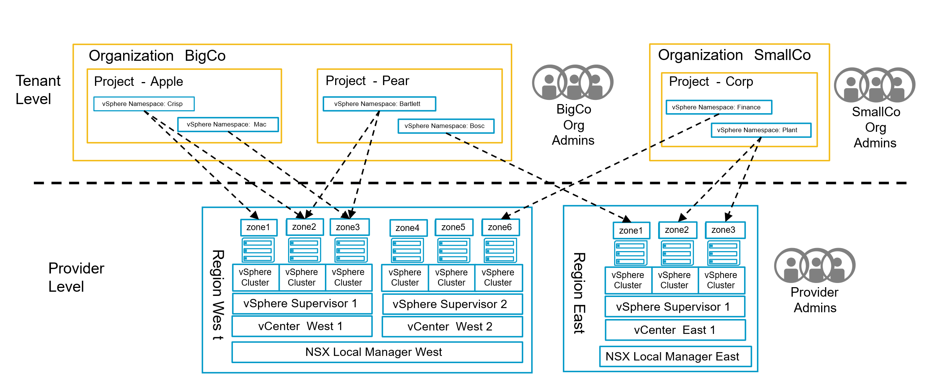
Example – Supervisor to Organization Relationship (SVG Image)

Slide 22

VCFA Org Model v1
VCF Automation Organization for All Apps
Project
Project Admins
Zones
vSphere Namespace
VM Classes
Storage Classes
Org
Admins
Content Libraries
VPC
Connectivity Profile
Private VPC CIDR
Private TGW IP Blocks
w.x.y.z
a.b.c.d
Org IAM
Org IdP
VCF Automation Provider Level
zone1
zone2
zone3
Provider Gateway
Regional Quota
vSphere
Cluster
vSphere
Cluster
vSphere
Cluster
Shared Content Libraries
T0 Gateway
Region
Default Namespaces
External IP Blocks
Provider Admins
vSphere Supervisor
StorageClasses
e.f.g.h
vCenter
VirtualMachineClasses
NSX Local Manager
Provider IAM
Provider IdP
Notes:
Talk Track:
Technical view of showing further detail on how multiple organizations/tenants with multiple projects can be assigned on certain resources within the vSphere Supervisor infrastructure.
Specifically, this view shows
2 Tenants across 2 Regions
Regions
Region 1 includes two separate vCenters sharing one NSX Manager deployment
Region 2 single vCenter/NSX Pair
Tenant #1 – BigCo
2 Projects
2 vSphere Namespaces per Project
Region Quotas
One Region Quota assigning resources to Region West - vSphere Supervisor 1
One Region Quota assigning resources to Region East - vSphere Supervisor 1
Tenant #2 – Small Co
1 Project
2 vSphere Namespaces
One Region Quota assigning resources to Region West - vSphere Supervisor 2
One Region Quota assigning resources to Region East - vSphere Supervisor 1
Note: Each Organization requires a Region Quota that maps the Supervisor in the Region to the Organization. Each Region can only map 1 Supervisor per region. This is why you see BigCo mapped to Region West Supervisor 1 and SmallCo mapped to Region West Supervisor 2.

Slide 23
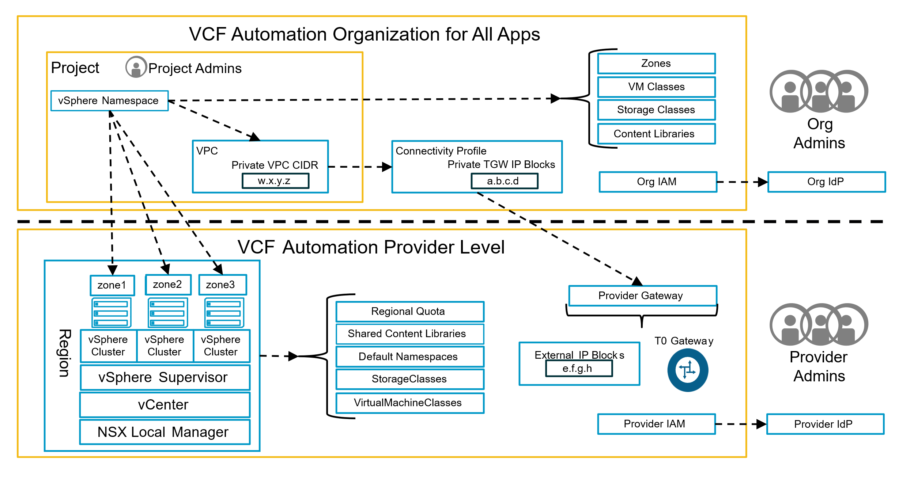
VCFA Org Model (SVG)

Slide 24
VCF Operations Models

Slide 25
VCF Operations Models v1
Simple - VCF Operations
High Availability - VCF Operations
VCF Operations
VCF Instance Account
VCF Operations
VCF Operations
(Fleet Management)
Management Domain
VCF Operations
(Fleet Management)
VCF Operations
Primary node
vCenter Adapter
VCF Operations
Primary node
vSAN Adapter
VCF Instance Account
NSX Adapter
Management Domain
VCF Operations
Replica node
vCenter Adapter
Workload Domain
VCF Operations
Data node
vSAN Adapter
vCenter Adapter
NSX Adapter
VCF Operations Collectors
vSAN Adapter
VCF Operations
Collector node
NSX Adapter
Workload Domain
vCenter Adapter
VCF Operations Collectors
vSAN Adapter
VCF Operations
Collector node
NSX Adapter

Slide 26
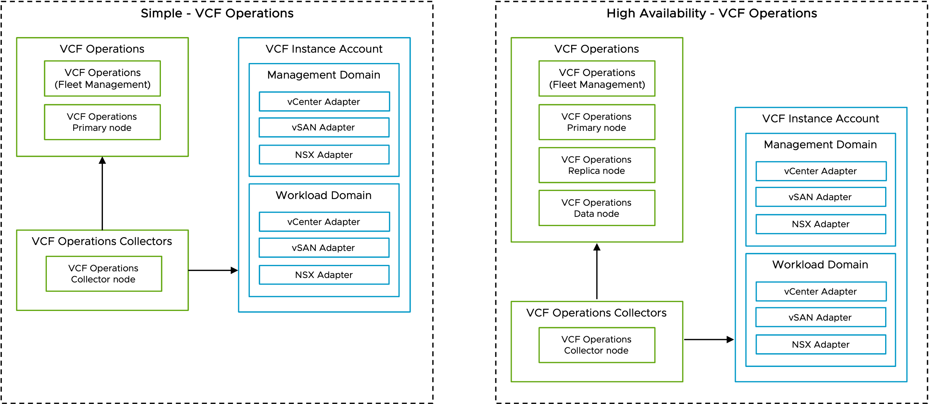
VCF Operations Models v1 (SVG Image)

